Slide 1
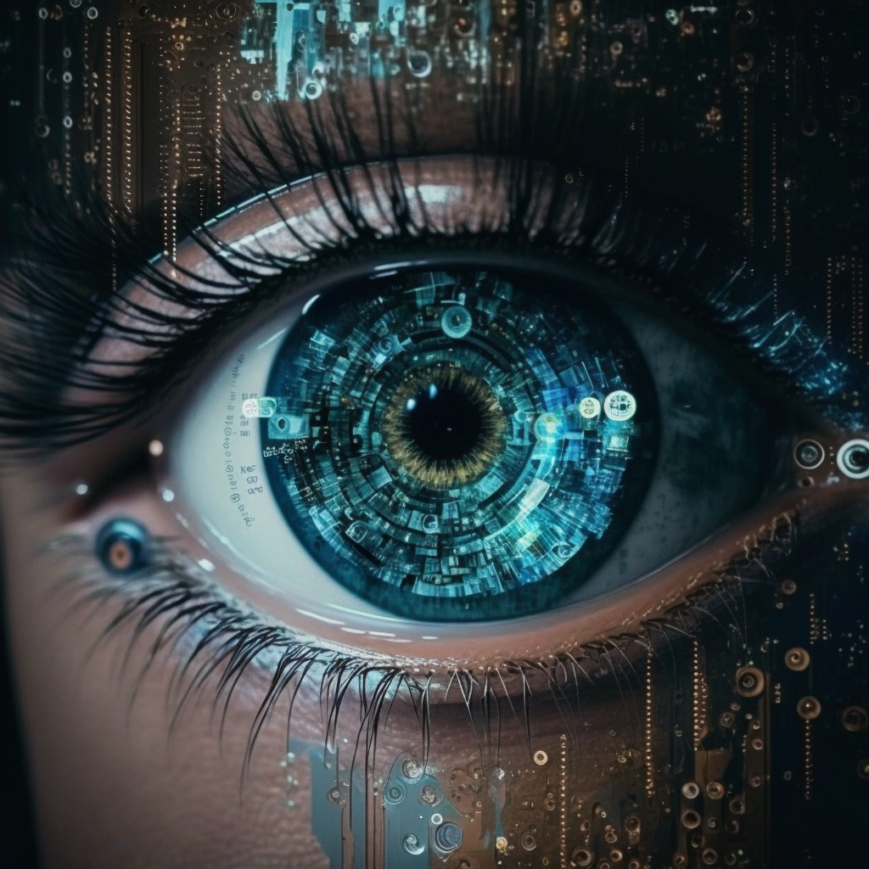
computer vision
midjourney bot (2023)

Slide 2
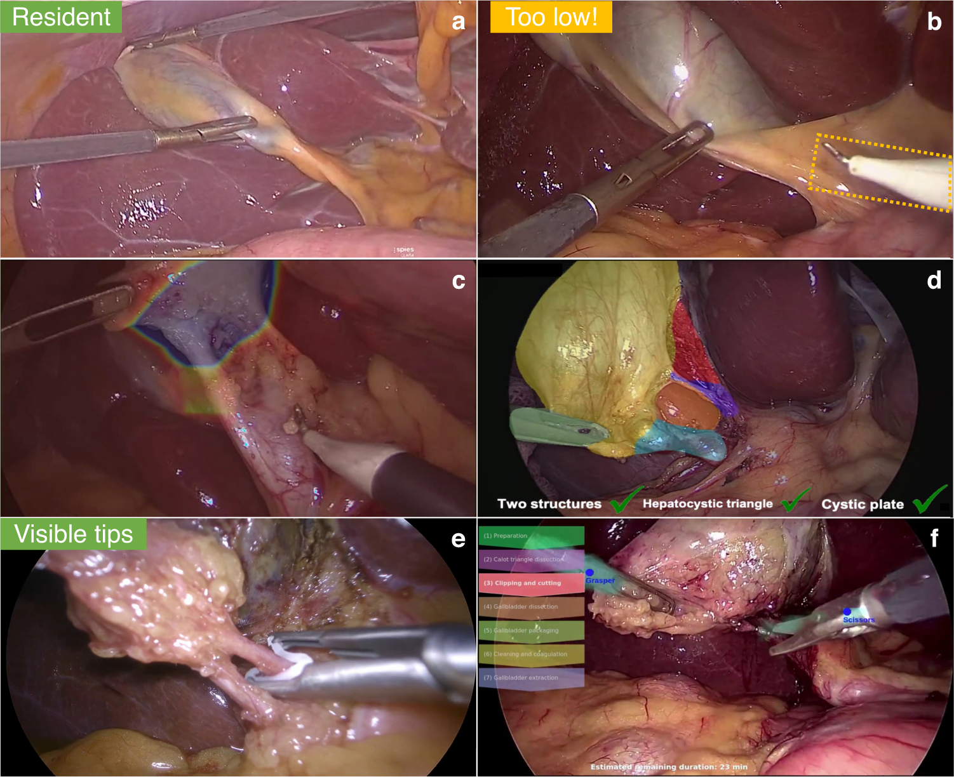
computer vision
Derive meaningful information from digital images, videos and other visual inputs.
Take actions or make recommendations based on that information.
Mascagni, P., Alapatt, D., Sestini, L. et al. Computer vision in surgery: from potential to clinical value. npj Digit. Med. 5, 163 (2022)
Notes:
Fig. 2. CV-based real-time assistance in laparoscopic cholecystectomy. Overviewed CV models could be used to evaluate the difficulty of a case and whether it is fit for a surgical resident (a), to warn surgeons against incising below the appropriate site (b), to guide safe dissection (c), to automatically evaluate safety measures (d), to prevent misapplications of clips (e) and to improve OR staff awareness and readiness.

Slide 3
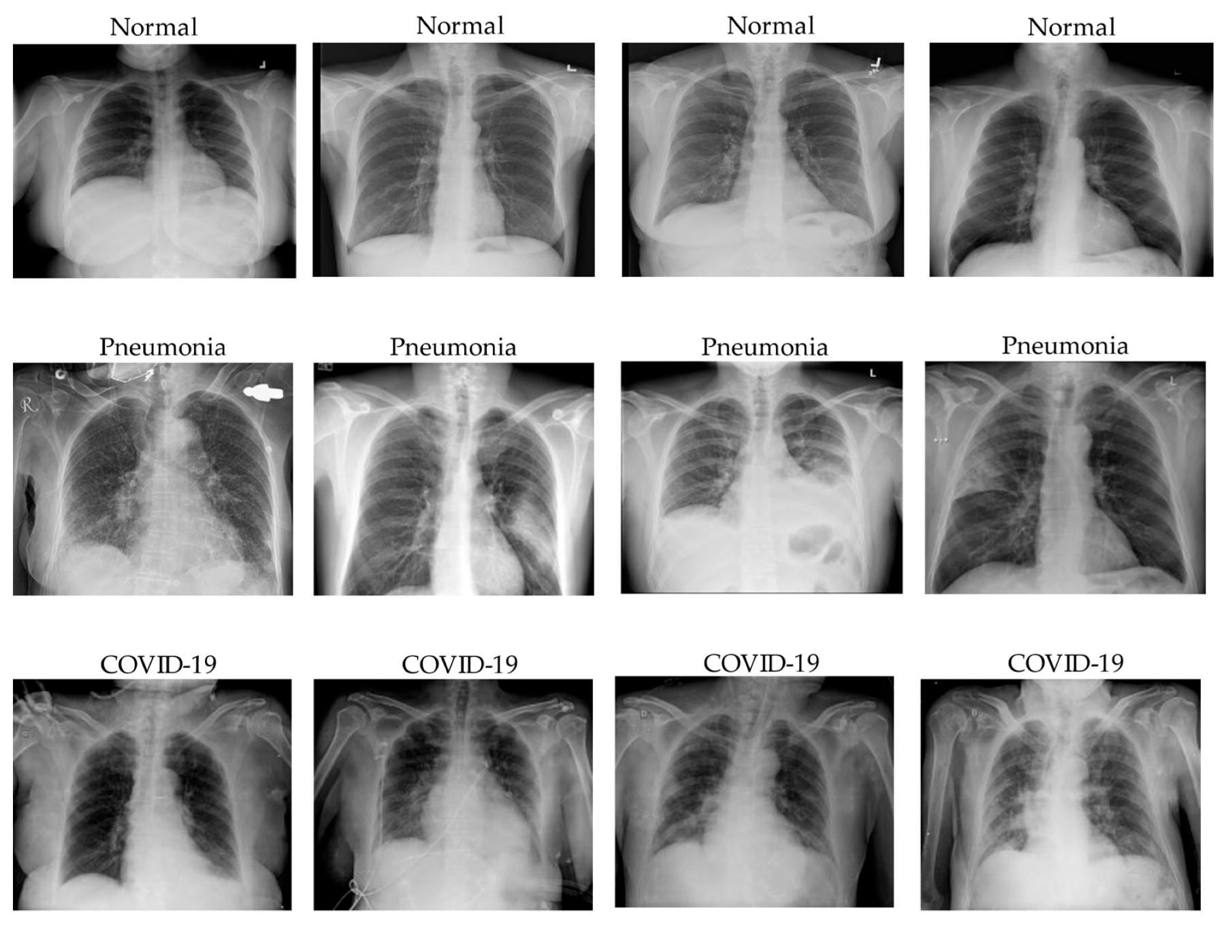
computer vision
Classification: predict the class(es) an image or video belongs to.
Le Dinh, T, et al. COVID-19 Chest X-ray Classification and Severity Assessment Using Convolutional and Transformer Neural Networks. Appl. Sci. 2022, 12, 4861

Slide 4
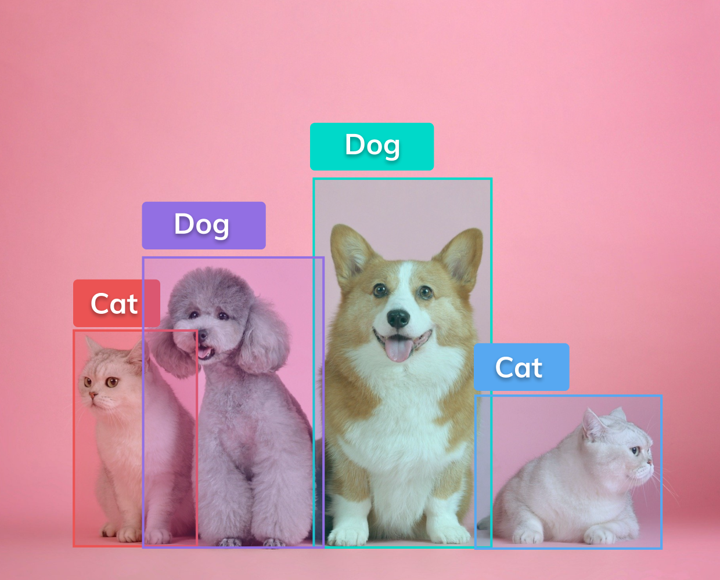
computer vision
Classification: predict the class(es) an image or video belongs to.
Object detection: identify a certain class of image and then detect and tabulate their appearance in an image or video.

Slide 5
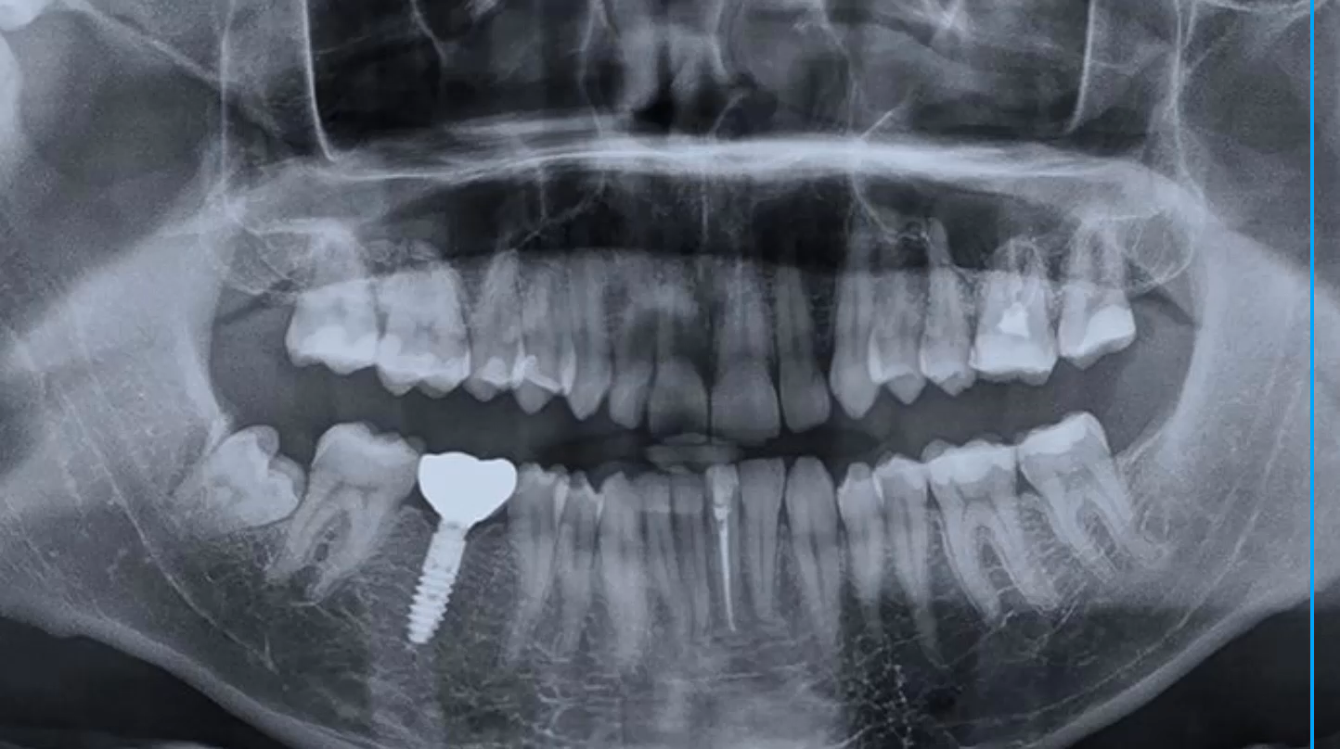
computer vision
Classification: predict the class(es) an image or video belongs to.
Object detection: identify a certain class of image and then detect and tabulate their appearance in an image or video.

Slide 6
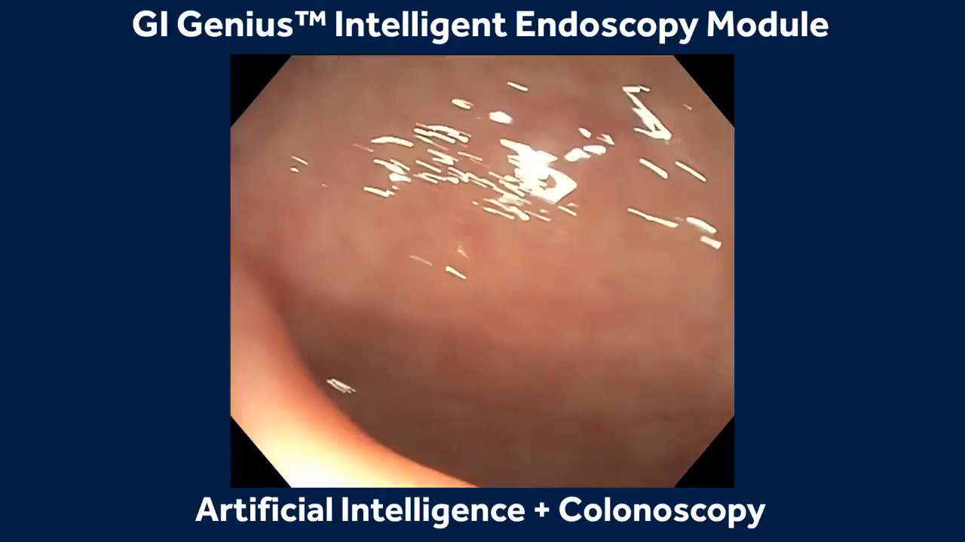
computer vision
Classification: predict the class(es) an image or video belongs to.
Object detection: identify a certain class of image and then detect and tabulate their appearance in an image or video.

Slide 7
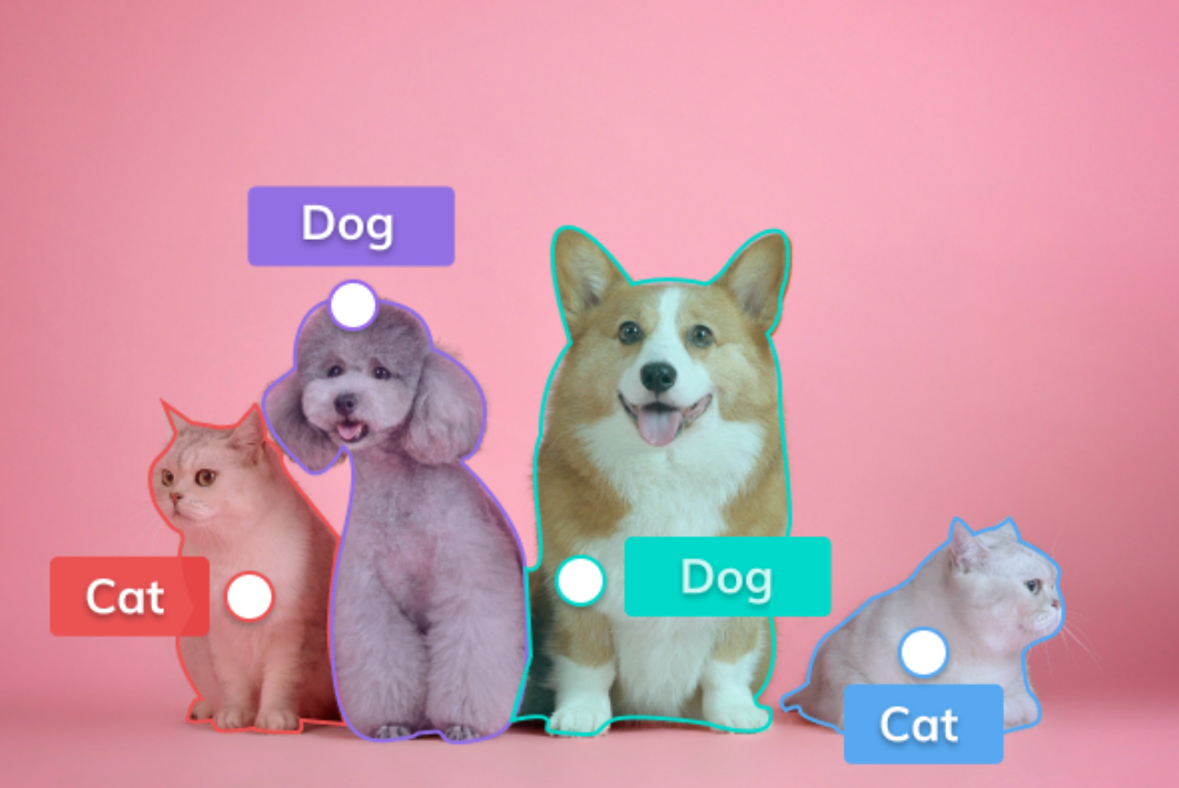

computer vision
Classification: predict the class(es) an image or video belongs to.
Object detection: identify a certain class of image and then detect and tabulate their appearance in an image or video.
Segmentation: the process of partitioning a digital image into multiple image segments (regions).
Machine Learning Methods for Biomedical Data (D012554)

Slide 8
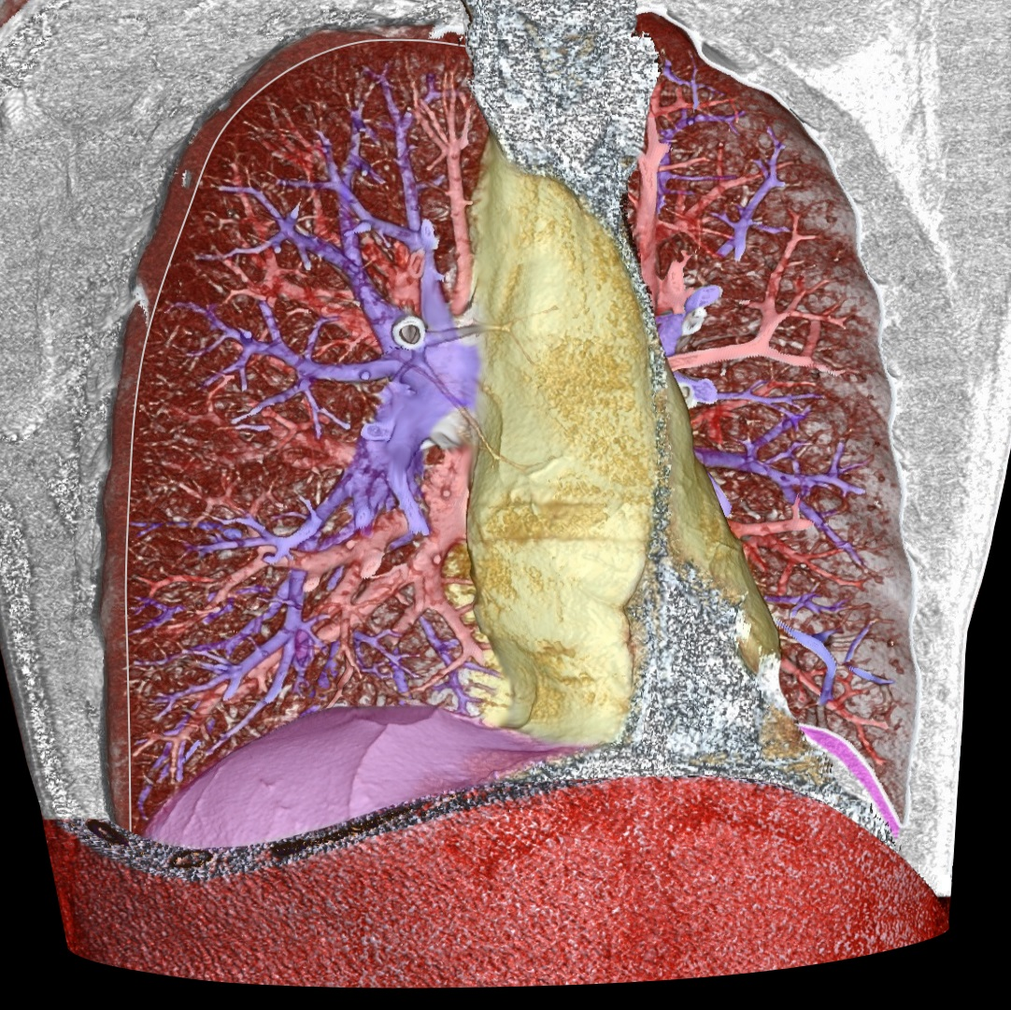
computer vision
Classification: predict the class(es) an image or video belongs to.
Object detection: identify a certain class of image and then detect and tabulate their appearance in an image or video.
Segmentation: the process of partitioning a digital image into multiple image segments (regions).
pulmonary arteries: blue; pulmonary veins (and also the abdominal wall): red; the mediastinum: yellow; the diaphragm: violet

Slide 9
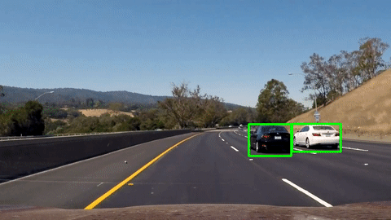
computer vision
Classification: predict the class(es) an image or video belongs to.
Object detection: identify a certain class of image and then detect and tabulate their appearance in an image or video.
Segmentation: the process of partitioning a digital image into multiple image segments (regions).
Object tracking: follow the movement of an object in a video.

Slide 10
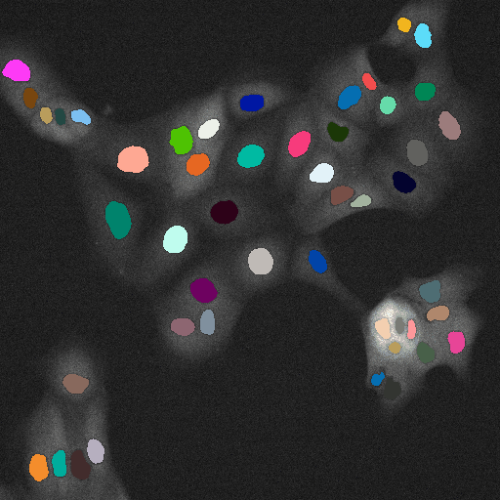
computer vision
Classification: predict the class(es) an image or video belongs to.
Object detection: identify a certain class of image and then detect and tabulate their appearance in an image or video.
Segmentation: the process of partitioning a digital image into multiple image segments (regions).
Object tracking: follow the movement of an object in a video.
https://imaging.cs.msu.ru/en/research/cell-tracking

Slide 11
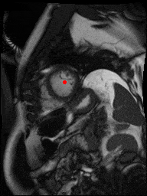
computer vision
Classification: predict the class(es) an image or video belongs to.
Object detection: identify a certain class of image and then detect and tabulate their appearance in an image or video.
Segmentation: the process of partitioning a digital image into multiple image segments (regions).
Object tracking: follow the movement of an object in a video.
kaggle.com/second-annual-data-science-bowl (2015)

Slide 12
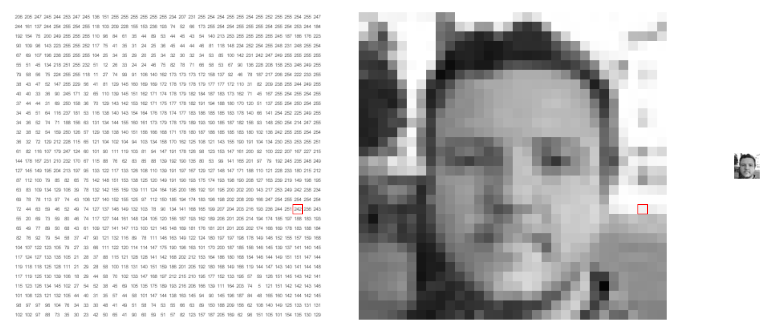
what computers see
https://setosa.io/ev/image-kernels/
Notes:
Shifts
Scale
anngles
Shadows

Slide 13
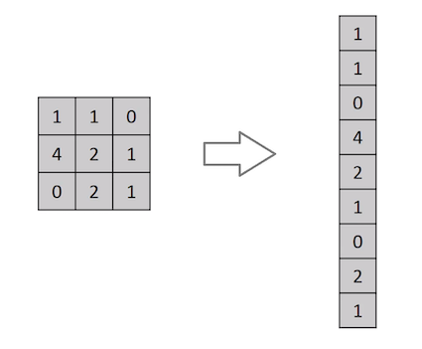
flatten
We could just represent each pixel as a feature.
This would mean that we flatten the 2D matrix to a 1D feature vector.
The learning algorithm then needs to learn the 2D spatial correlations from the 1D representation.
And what with the invariances?
Notes:
Shifts
Scale
anngles
Shadows

Slide 14
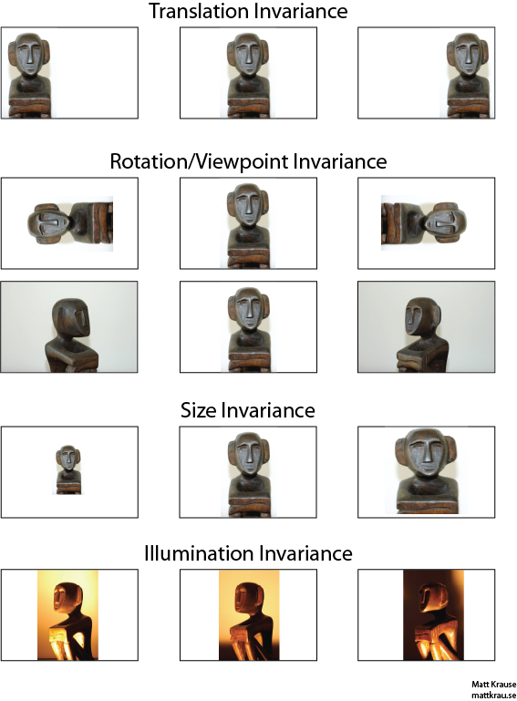
invariances
Invariance means that we can recognize an object as an object, even when its appearance varies in some way.
Notes:
Shifts
Scale
anngles
Shadows

Slide 15
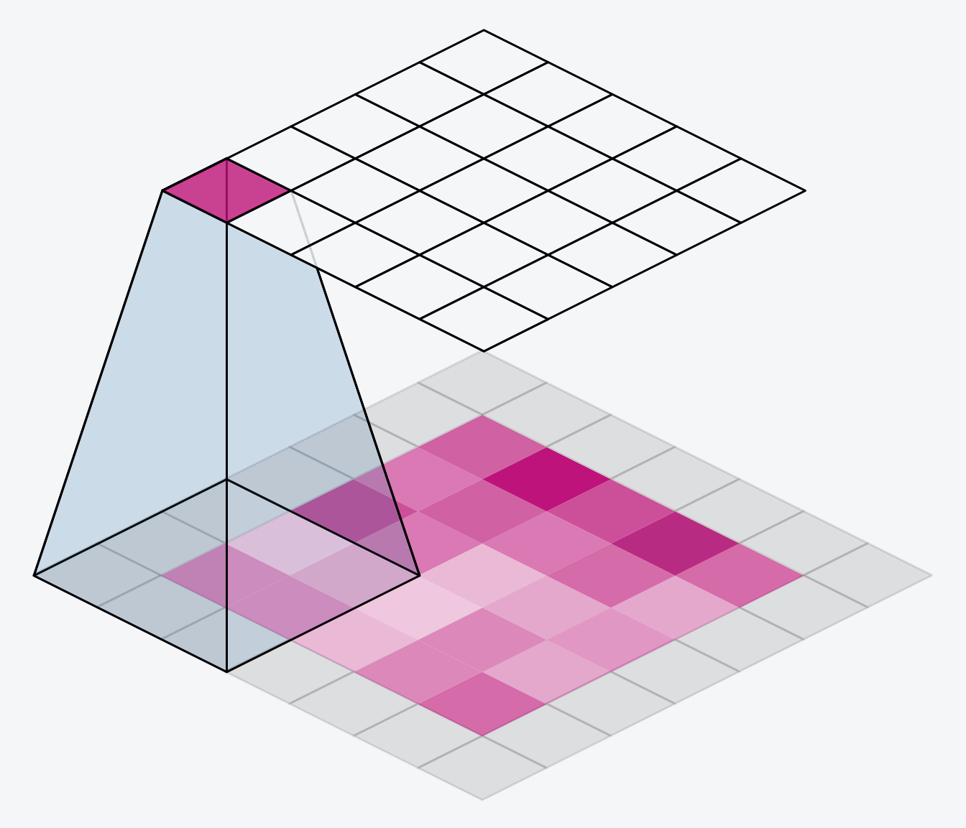
convolutional filters (aka kernels)
Convolutional filters are small matrices that slide over input data to detect patterns like edges and textures.
output “image”
input image

Slide 16
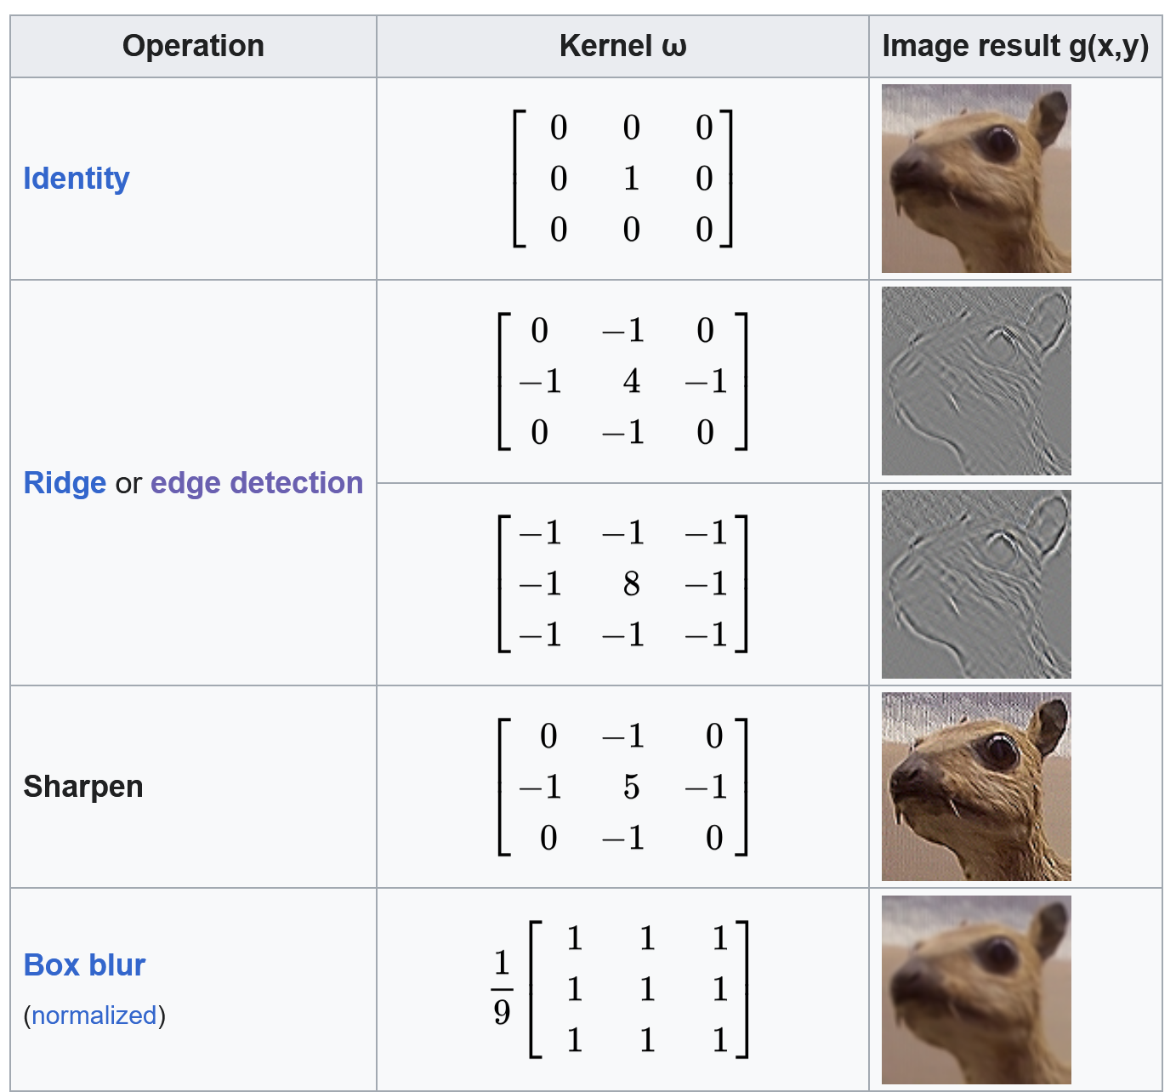
convolutional filters (aka kernels)
Convolutional filters are small matrices that slide over input data to detect patterns like edges and textures.
Each filter learns unique weights during training to extract specific features.
Multiple filters can be convolved over the same image, where ideally each filter learns different patterns.

Slide 17
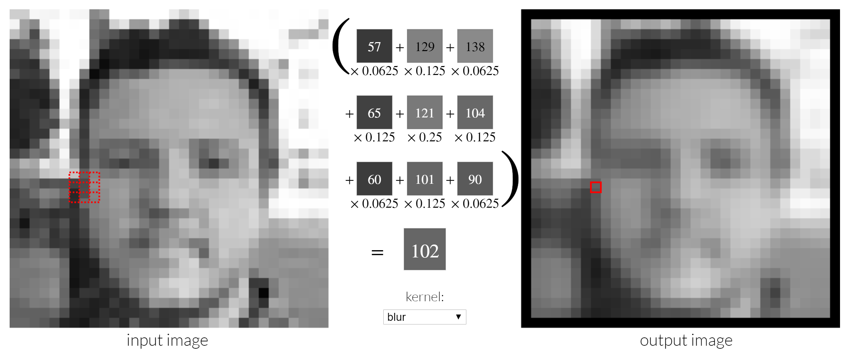
convolutional filters (aka kernels)
Convolutional filters are small matrices that are “slided” over an image.
They provides a measure for how close a patch or a region in the image resembles a feature.
Notes:
Shifts
Scale
anngles
Shadows

Slide 18



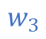

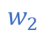



convolutional filters (aka kernels)
Convolutional filters are small matrices that are “slided” over an image.
They provides a measure for how close a patch or a region in the image resembles a feature.
$$w_{1}$$
$$w_{2}$$
$$w_{3}$$
$$w_{4}$$
$$w_{5}$$
$$w_{6}$$
$$w_{7}$$
$$w_{8}$$
$$w_{9}$$
Notes:
Shifts
Scale
anngles
Shadows

Slide 19
convolutional filters (aka kernels)
Convolutional filters are small matrices that slide over input data to detect patterns like edges and textures.
Each filter learns unique weights during training to extract specific features.
Multiple filters can be convolved over the same image, where ideally each filter learns different patterns.
Filter size and padding defines the shape of the output image
output “image”
learnable weights
input image

Slide 20


channels & dimensions
Notes:
Shifts
Scale
anngles
Shadows

Slide 21
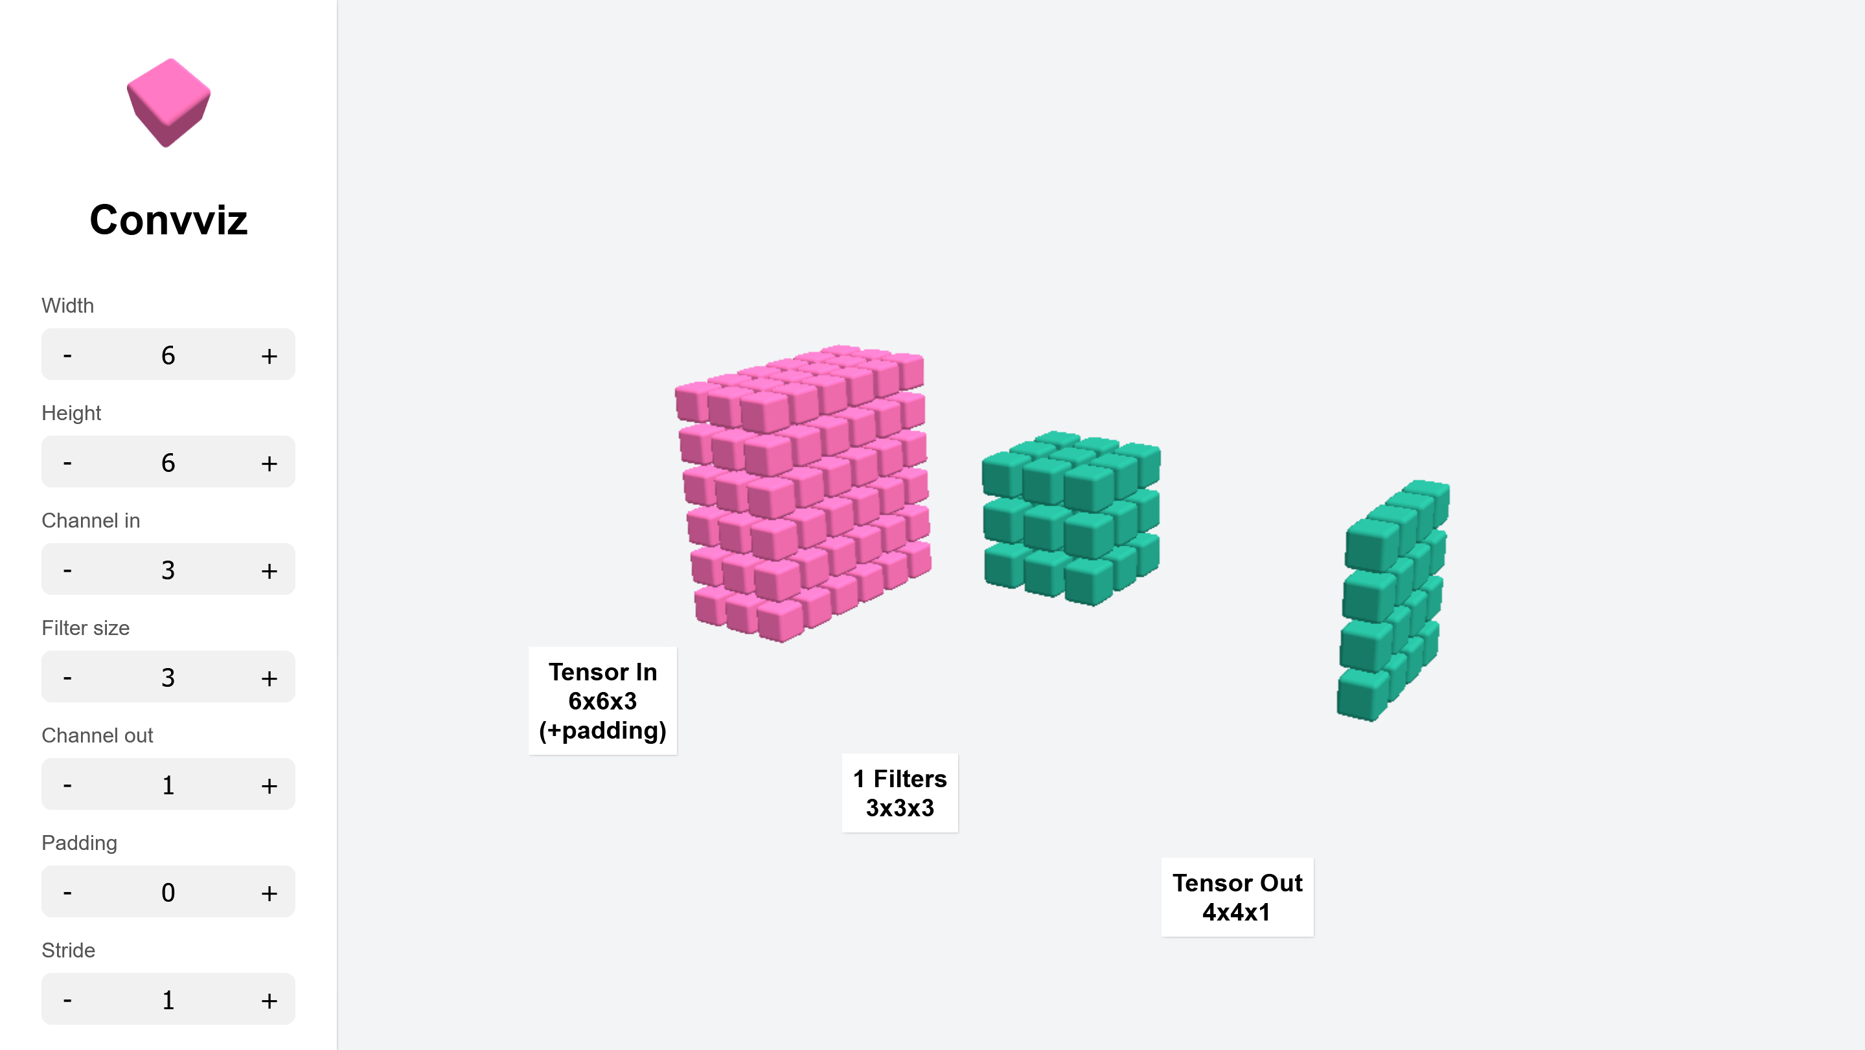
channels & dimensions
Notes:
Shifts
Scale
anngles
Shadows

Slide 22
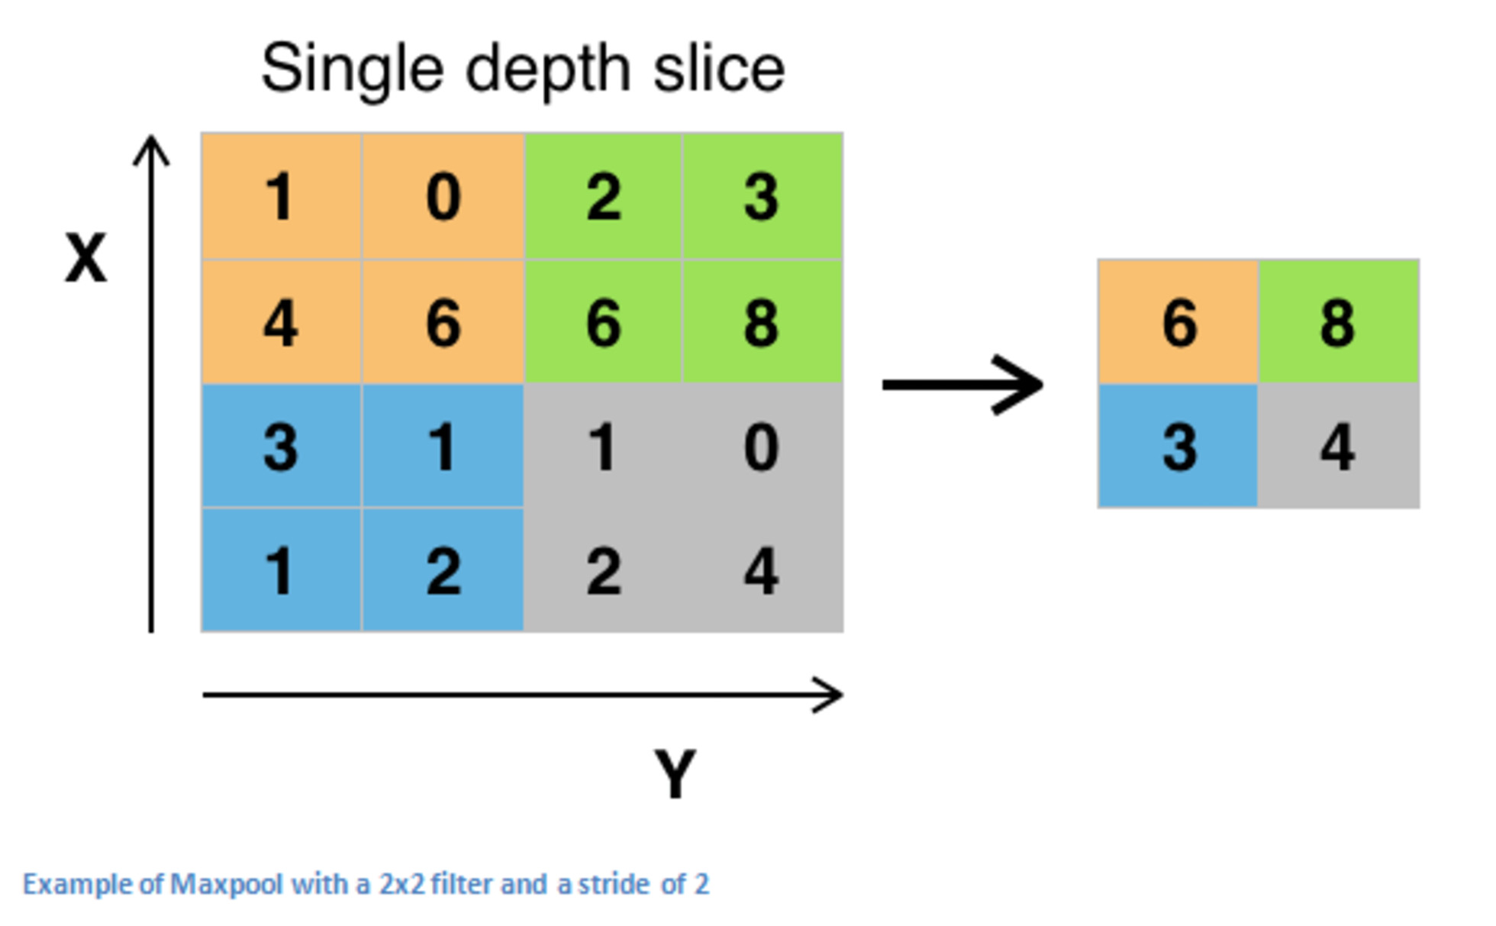
pooling
Maximum pooling, or max pooling, is a specialized filter without learnable weights that calculates the maximum (highest) value in each patch of each feature map.
Notes:
Shifts
Scale
anngles
Shadows

Slide 23

convolutional neural networks (CNN)
A convolutional neural network (CNN) stacks modules that consist of:
- convolutional layers that each learn relevant convolutional filters
- a pooling layer that allows for the location invariance of the learned features
Notes:
Image from: https://towardsdatascience.com/a-comprehensive-guide-to-convolutional-neural-networks-the-eli5-way-3bd2b1164a53

Slide 24
convolutional neural networks (CNN)
Typical CNN structure:
Alternate between N convolutional layers and a max pooling layer
Decrease the ‘image resolution` and increase the number of channels throughout the network
End by flattening the output of the final max pooling
Combine with a dense network to reach the desired output shape
Notes:
Image from: https://towardsdatascience.com/a-comprehensive-guide-to-convolutional-neural-networks-the-eli5-way-3bd2b1164a53

Slide 25
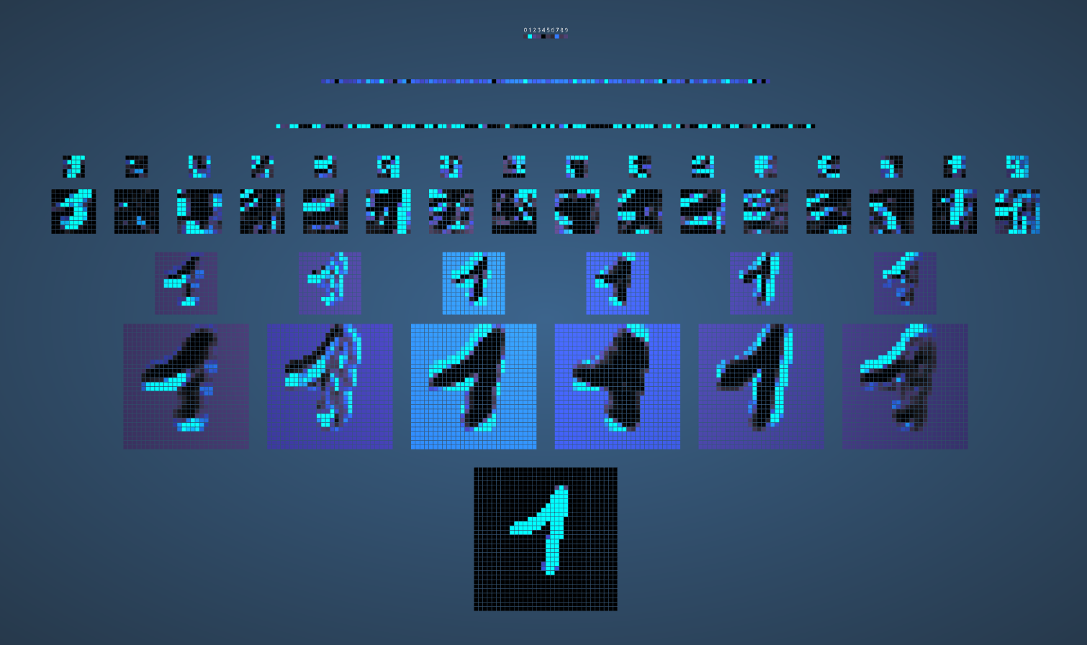
convolutional neural networks (CNN)
https://adamharley.com/nn_vis/cnn/2d.html

Slide 26
Invariances: data augmentation
CNNs are
translation invariant,
scale invariant to some degree (learned from data, not in filters),
not rotation invariant (learned from data),
not illumination invariant (learned from data).
We can generate artificial data, by rotating, scaling, illuminating training images. A process called data augmentation. This is a form of model regularization.
Notes:
Shifts
Scale
anngles
Shadows

Slide 27
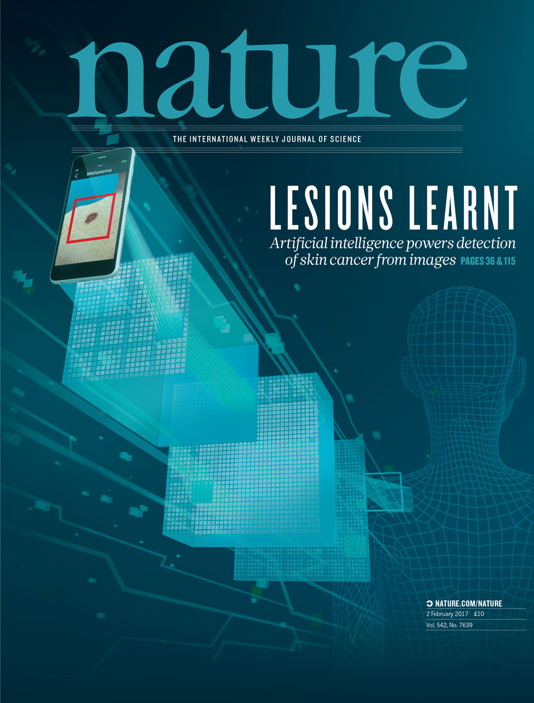
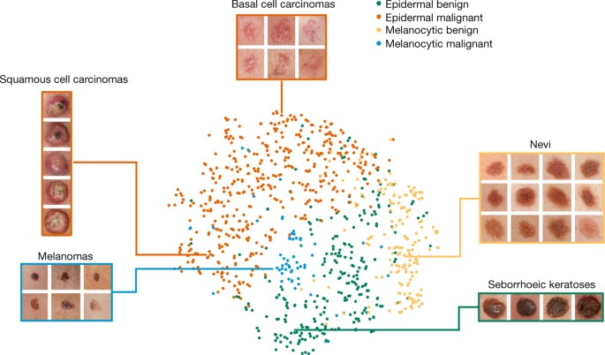
recent advances: melanoma
Thrun et al., Dermatologist-level classification of skin cancer with deep neural networks, Nature (2017)

Slide 28
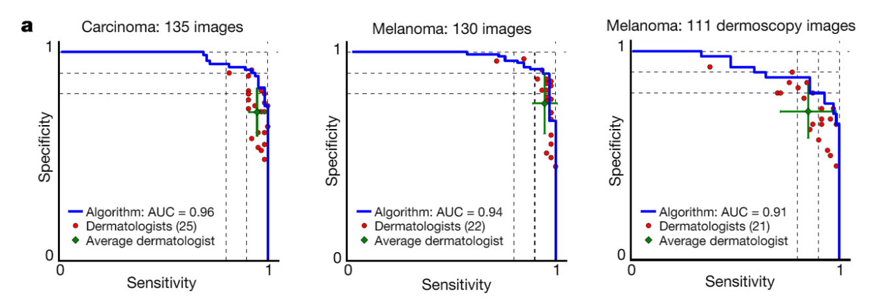
recent advances: melanoma
keratinocyte carcinomas: 65
benign seborrheic keratoses: 75
malignant melanomas: 33
benign nevi: 97
malignant melanomas: 71
benign nevi: 40
Thrun et al., Dermatologist-level classification of skin cancer with deep neural networks, Nature (2017)

Slide 29
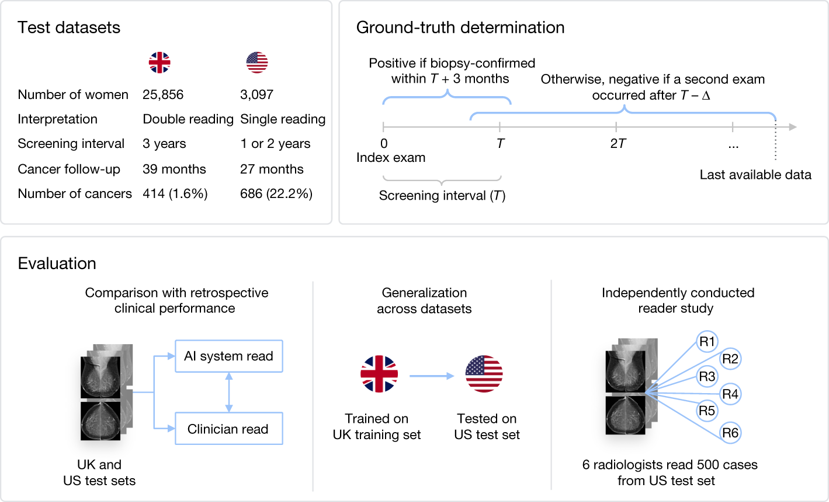
recent advances: breast cancer screening
McKinney, S.M., Sieniek, M., Godbole, V. et al. International evaluation of an AI system for breast cancer screening. Nature 577, 89–94 (2020)

Slide 30
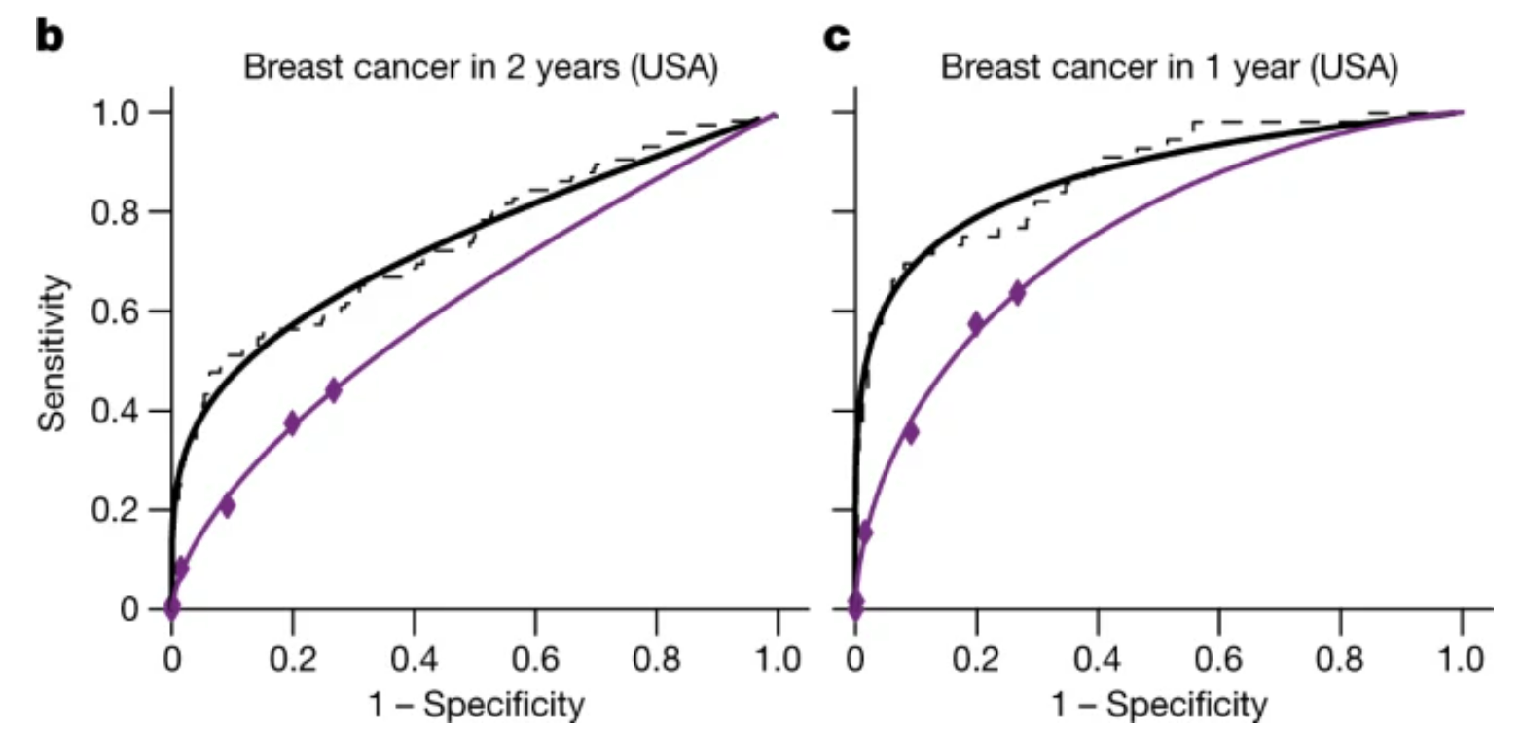
recent advances: breast cancer screening
Pooled ROC results from all six readers(purple) versus AI model (black).
McKinney, S.M., Sieniek, M., Godbole, V. et al. International evaluation of an AI system for breast cancer screening. Nature 577, 89–94 (2020)

Slide 31
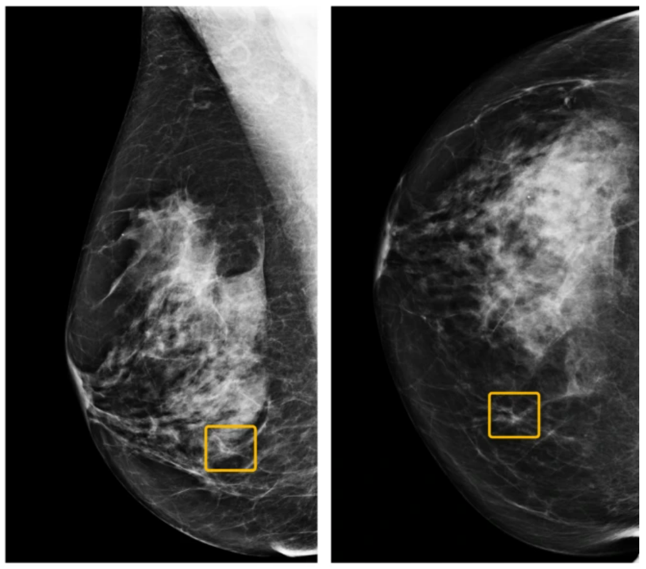
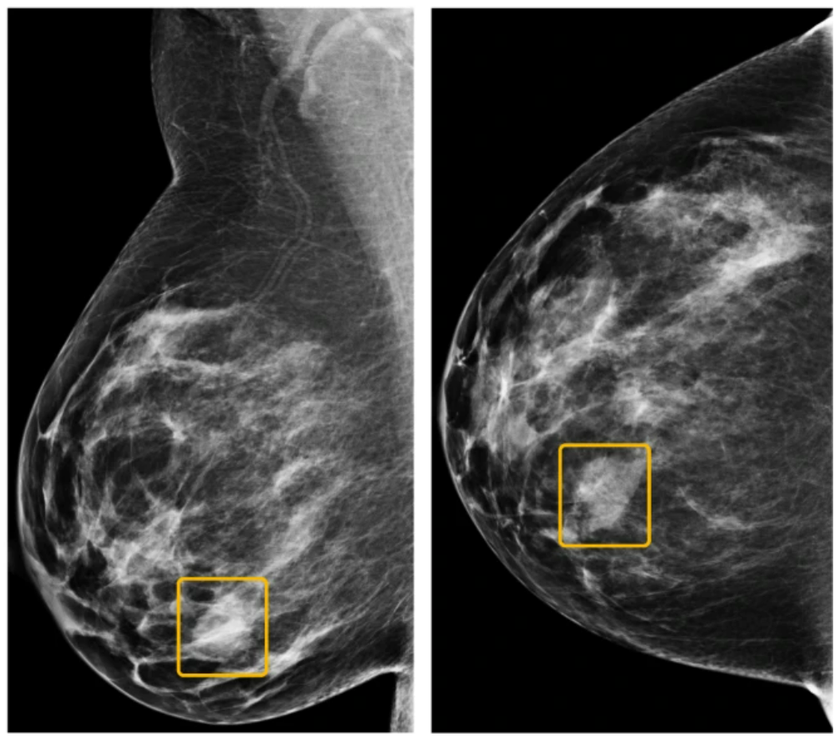
recent advances: breast cancer screening
missed by readers missed by AI model
McKinney, S.M., Sieniek, M., Godbole, V. et al. International evaluation of an AI system for breast cancer screening. Nature 577, 89–94 (2020)

Slide 32
what computers see
Notes:
Shifts
Scale
anngles
Shadows

Slide 33
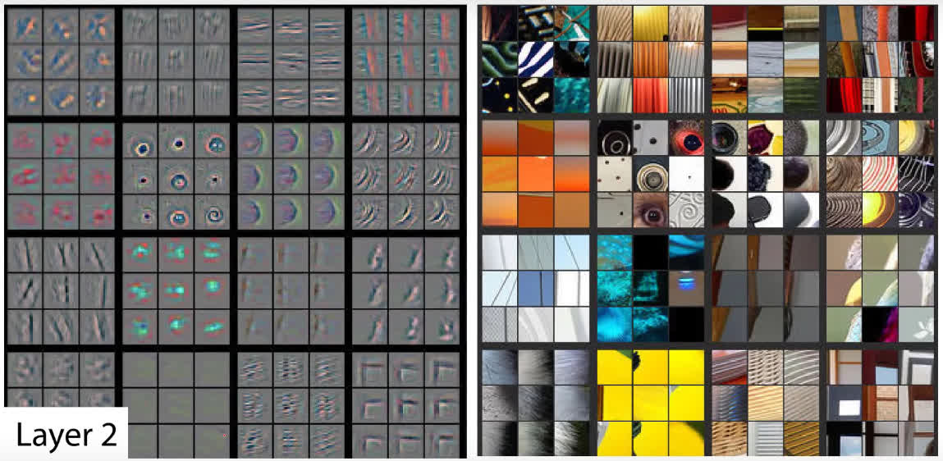
what computers see
On the left, each square is a different feature map (convolutional filter) with the activations shown for the corresponding images on the right (these images are selected such that they maximize the activation of the filter.
Zeiler, M. D., & Fergus, R. (2014, September). Visualizing and understanding convolutional networks. In European conference on computer vision (pp. 818-833)
Notes:
Shifts
Scale
anngles
Shadows

Slide 34
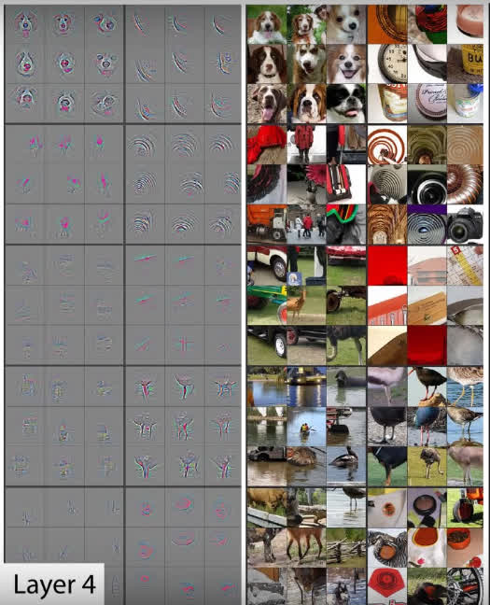
what computers see
The patterns that the filters detect become more complex as we go deeper into the network.
Zeiler, M. D., & Fergus, R. (2014, September). Visualizing and understanding convolutional networks. In European conference on computer vision (pp. 818-833)
Notes:
Shifts
Scale
anngles
Shadows

Slide 35
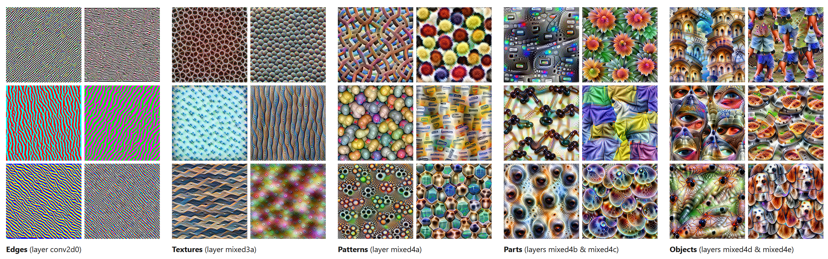
what computers see
https://distill.pub/2017/feature-visualization/

Slide 36
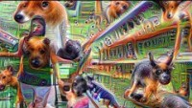
what computers see
Notes:
https://www.youtube.com/watch?v=SCE-QeDfXtA

Slide 37
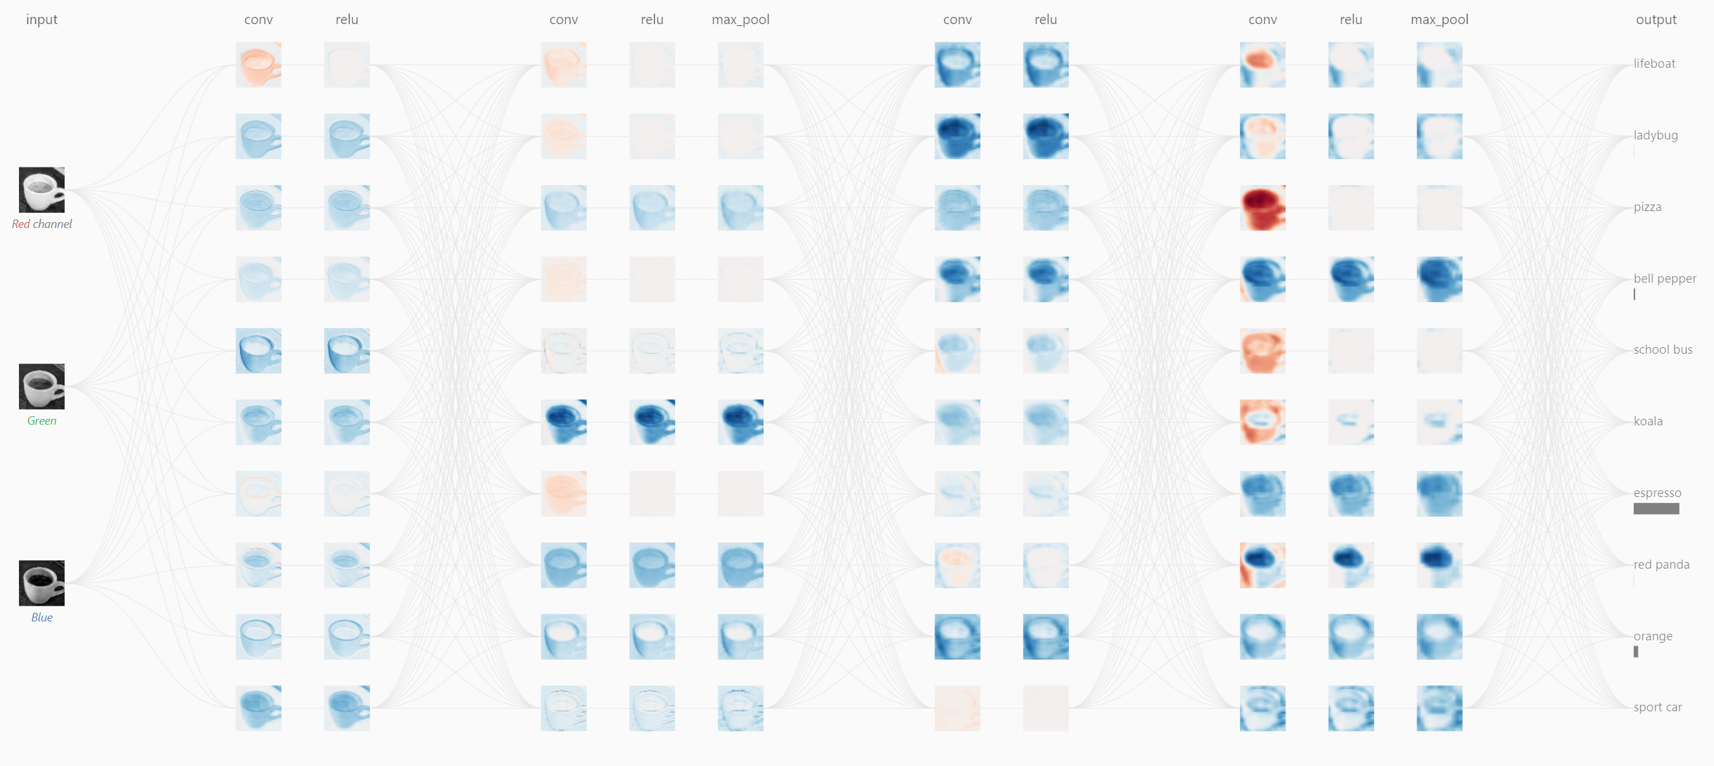
what computers see
https://poloclub.github.io/cnn-explainer/
Notes:
Shifts
Scale
anngles
Shadows

Slide 38
transfer learning
Thrun et al., Dermatologist-level classification of skin cancer with deep neural networks, Nature (2017)

Slide 39
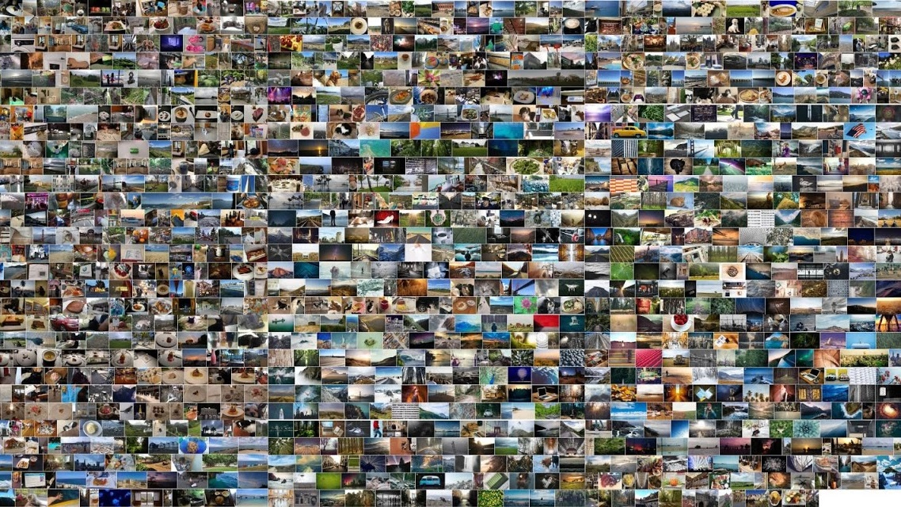
data is everything: ImageNet
J. Deng et al., "ImageNet: A large-scale hierarchical image database," 2009 IEEE Conference on Computer Vision and Pattern Recognition
Notes:
14.197.122 images
21.841 subcategories
27 high-level categories

Slide 40
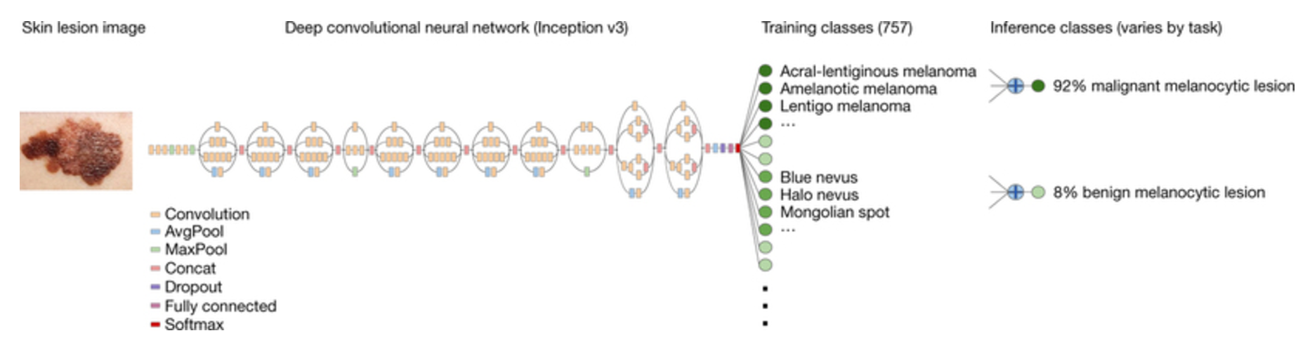
transfer learning
A pre-trained (on ImageNet) Inception v3 CNN was downloaded from GitHub.
The fully connected feed forward neural network module was replaced.
The network was then fine-tuned on the available lesion data. This means that the remainder of the model parameters were used as the network’s initialization.
Thrun et al., Dermatologist-level classification of skin cancer with deep neural networks, Nature (2017)

